Slide 1
Deshi Gadgets
Your Simple Choice for Electronics in Bangladesh

Slide 2


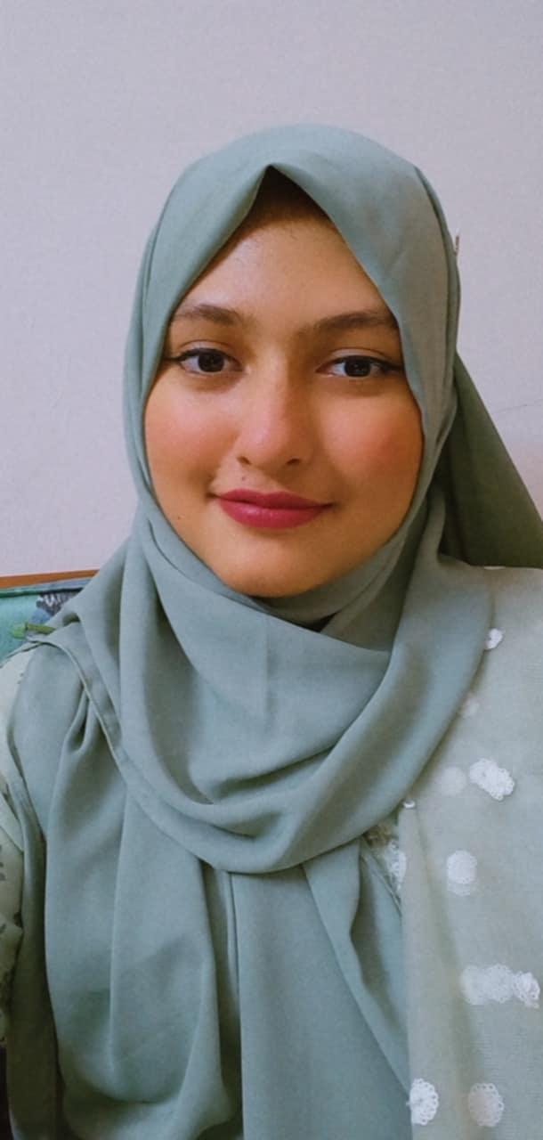
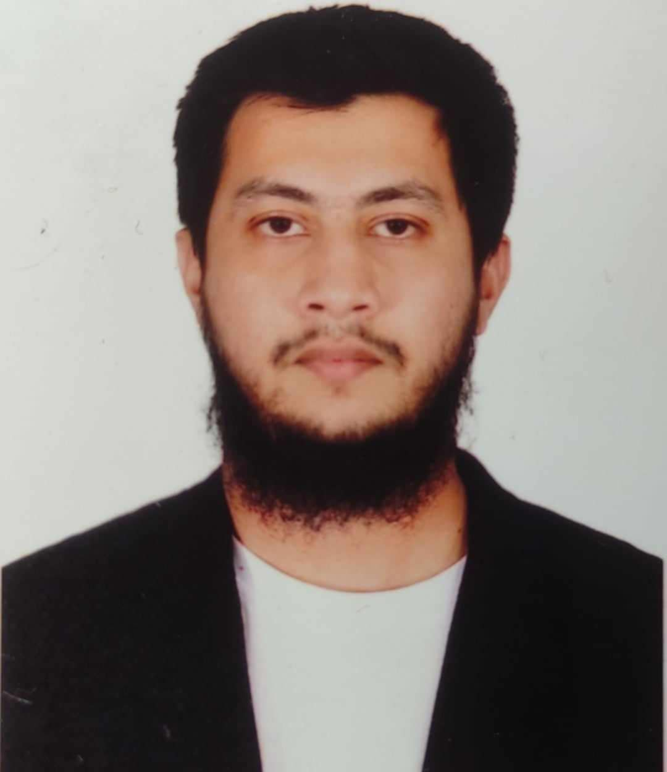
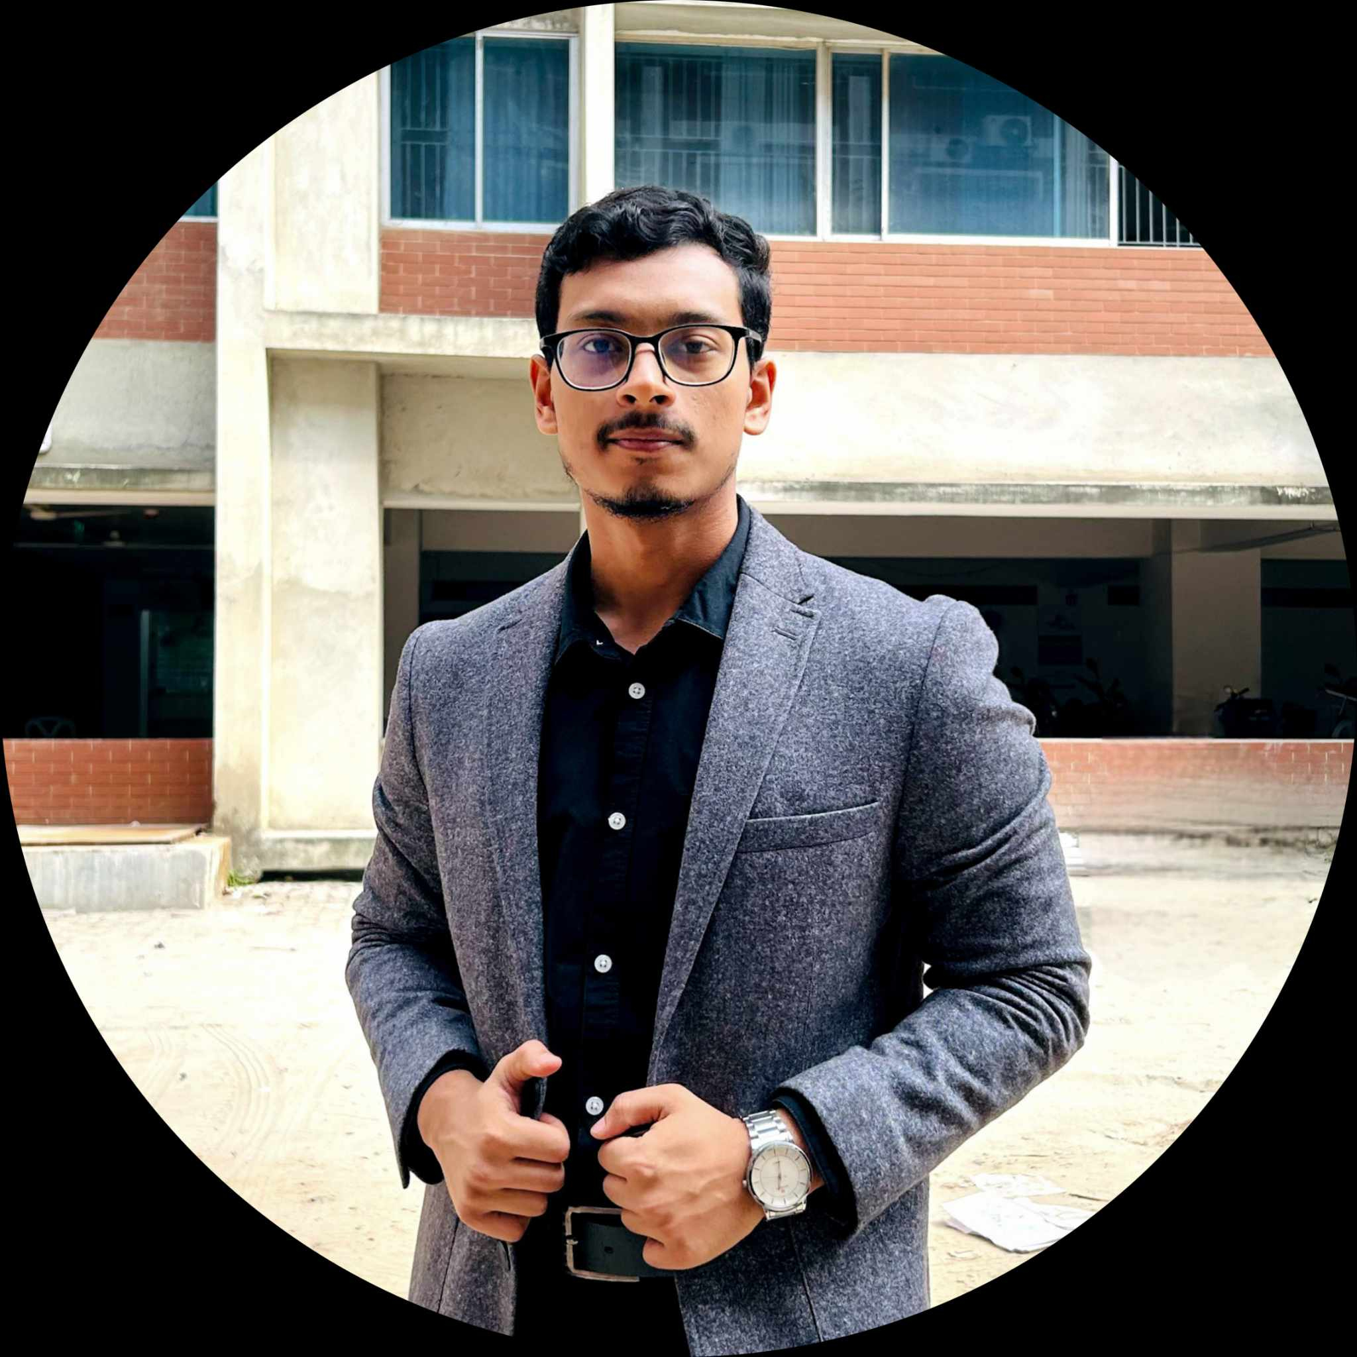
My Teammates,
Md Mehedi Hasan
Mahmuda Adeeba Tul Husna
Mehedi Hasan Pranto
21225103334
21225103333
21225103357
Abdullah Al Hill Baki
Mushfiqur Rahman Pulok
21225103341
21225103525

Slide 3
INTRODUCTION
“Deshi Gadgets" is a comprehensive e-commerce website designed for the online sale of electronic products. This project aims to provide users with a seamless shopping experience where they can browse a wide range of electronics, filter products by categories, add items to their cart, and make purchases through a simulated payment gateway. Additionally, it includes administrative functionalities to manage product listings and inventory.

Slide 4
Objective
01
User-Friendly Shopping Experience
02
Secure Transactions
03
Admin Control and Inventory Management
04
Automated Mailing

Slide 5
Current Progress
01
User registration and login features implemented.
02
Home Page Design
03
User Profile
04
User Update Profile

Slide 6
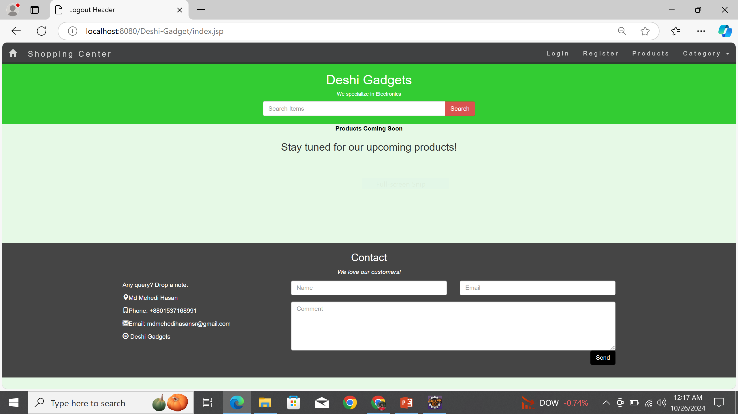
Home Page

Slide 7
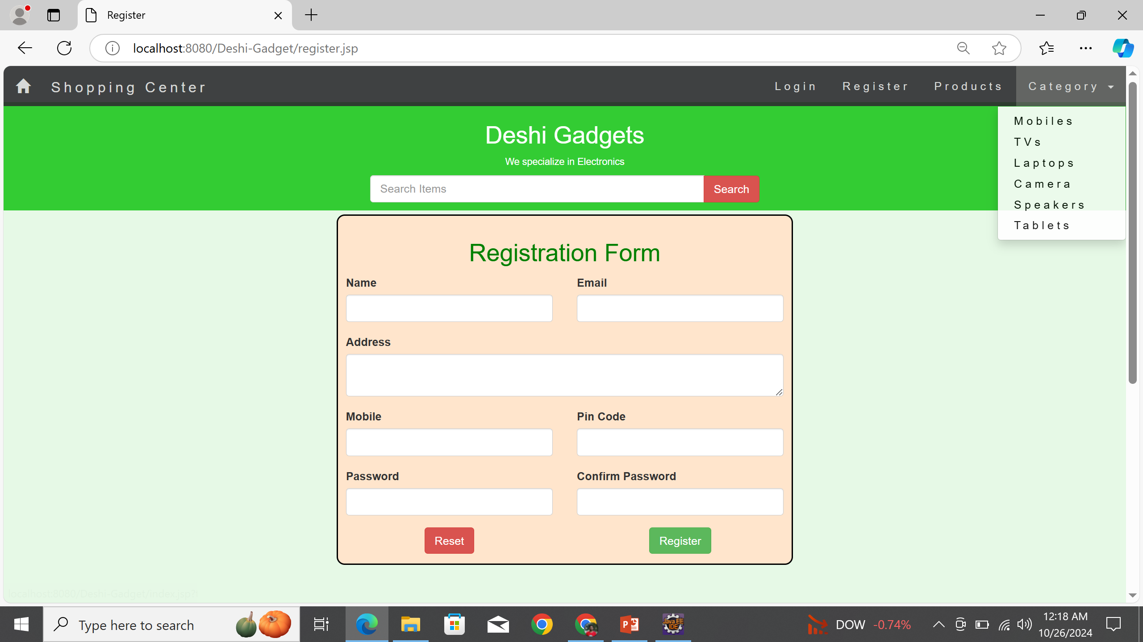
Registration Page

Slide 8
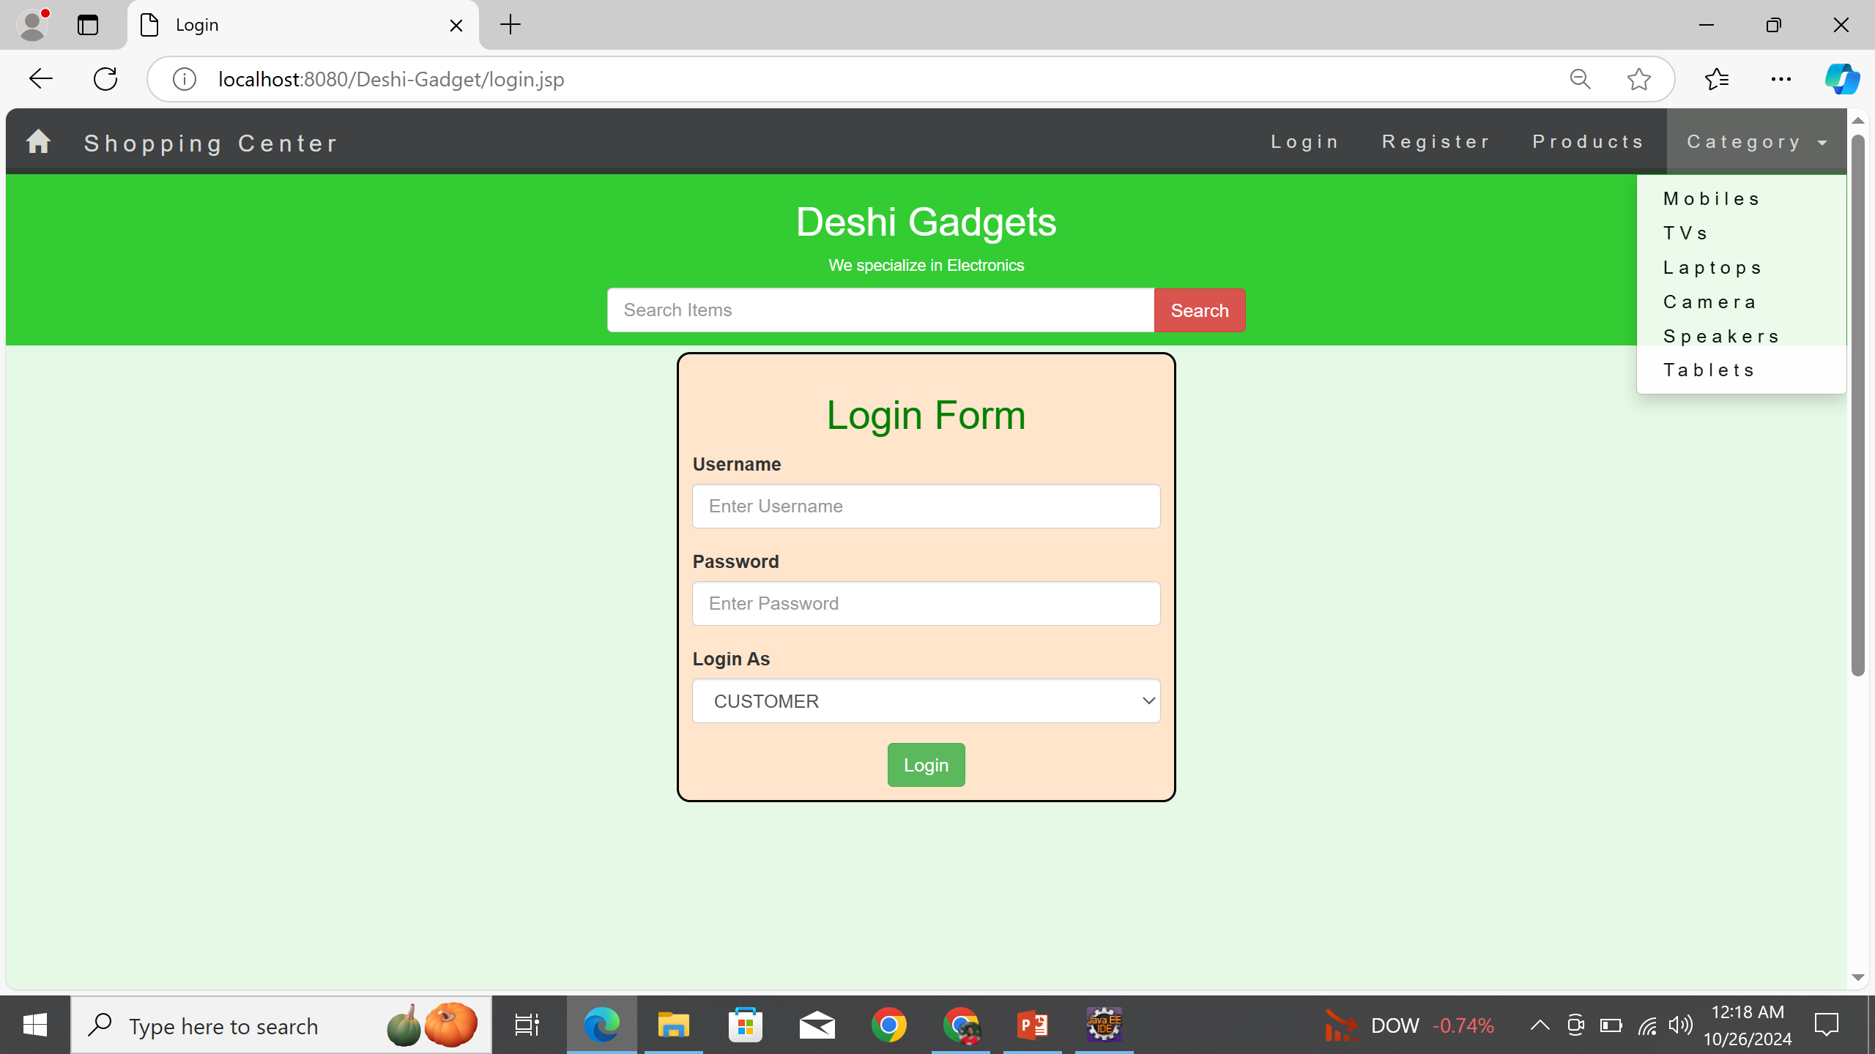
Login Page

Slide 9
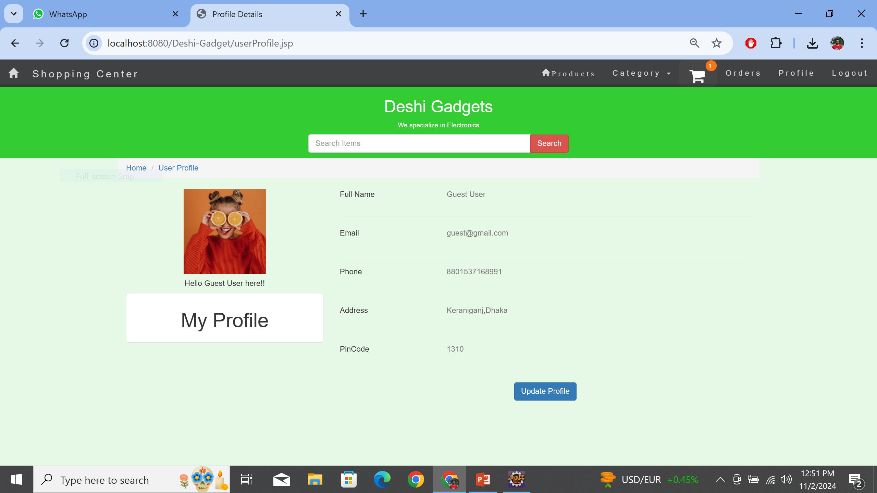
Profile Page

Slide 10
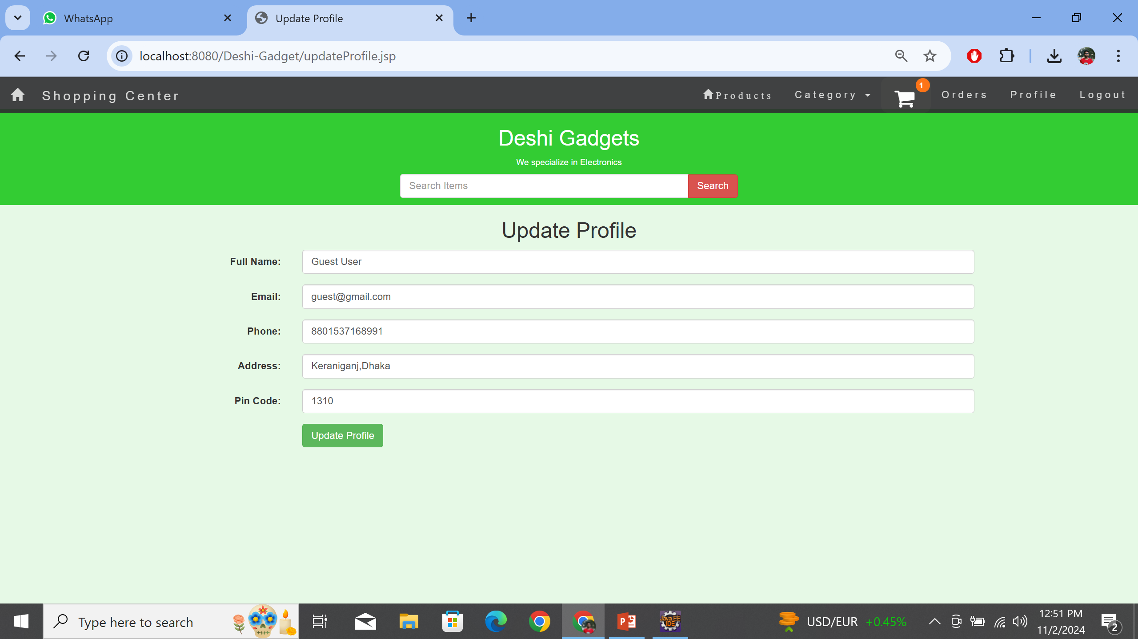
Update Profile Page

Slide 11
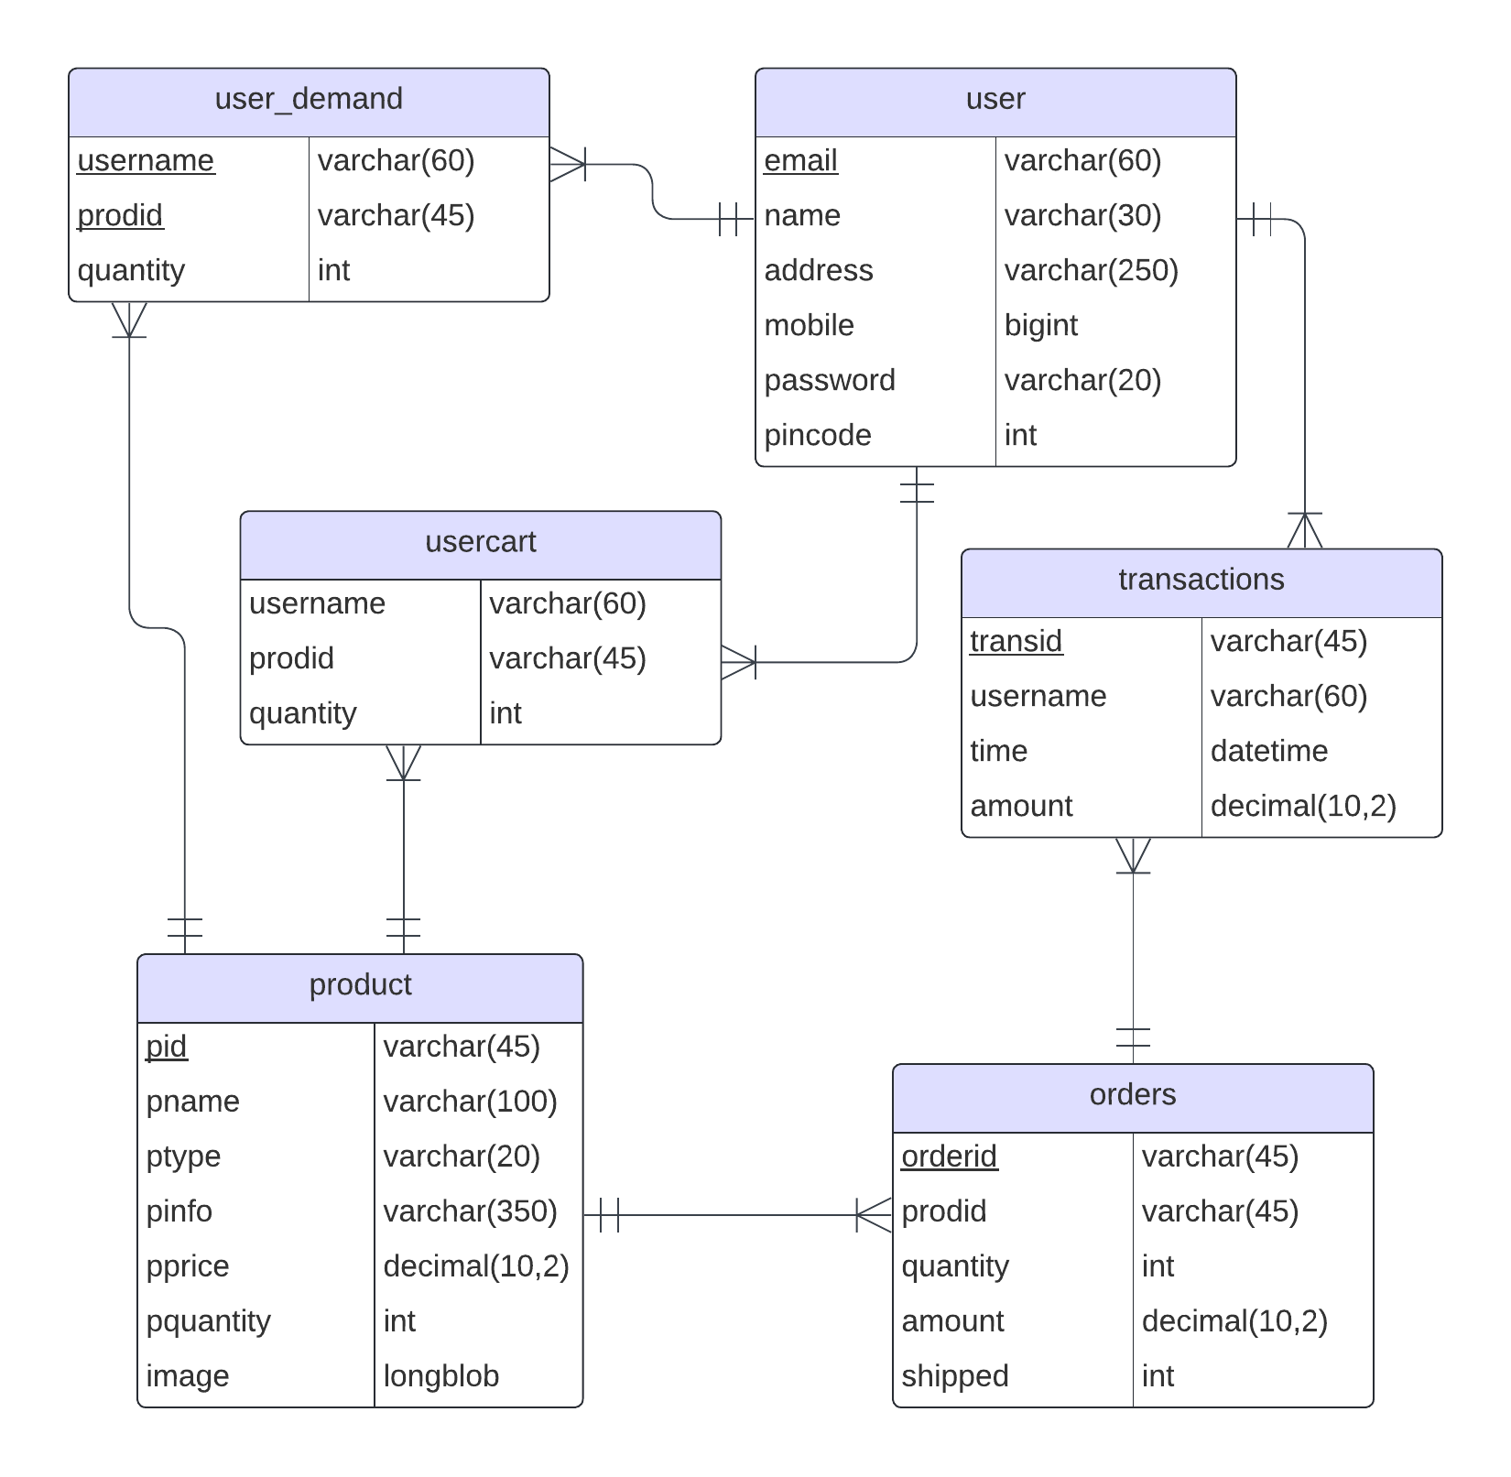
ER Diagram

Slide 12
Challenges Faced
01
Database Connection Issues
02
Environment Setup for JDK,MAVEN,MYSQL

Slide 13
Next Steps
01
Implement product browsing and search functionalities.
02
Develop the shopping cart feature for adding items.
03
Develop the admin control & inventory Management
04
Automated Mailing System
05
Develop the Payment Gateway

Slide 14
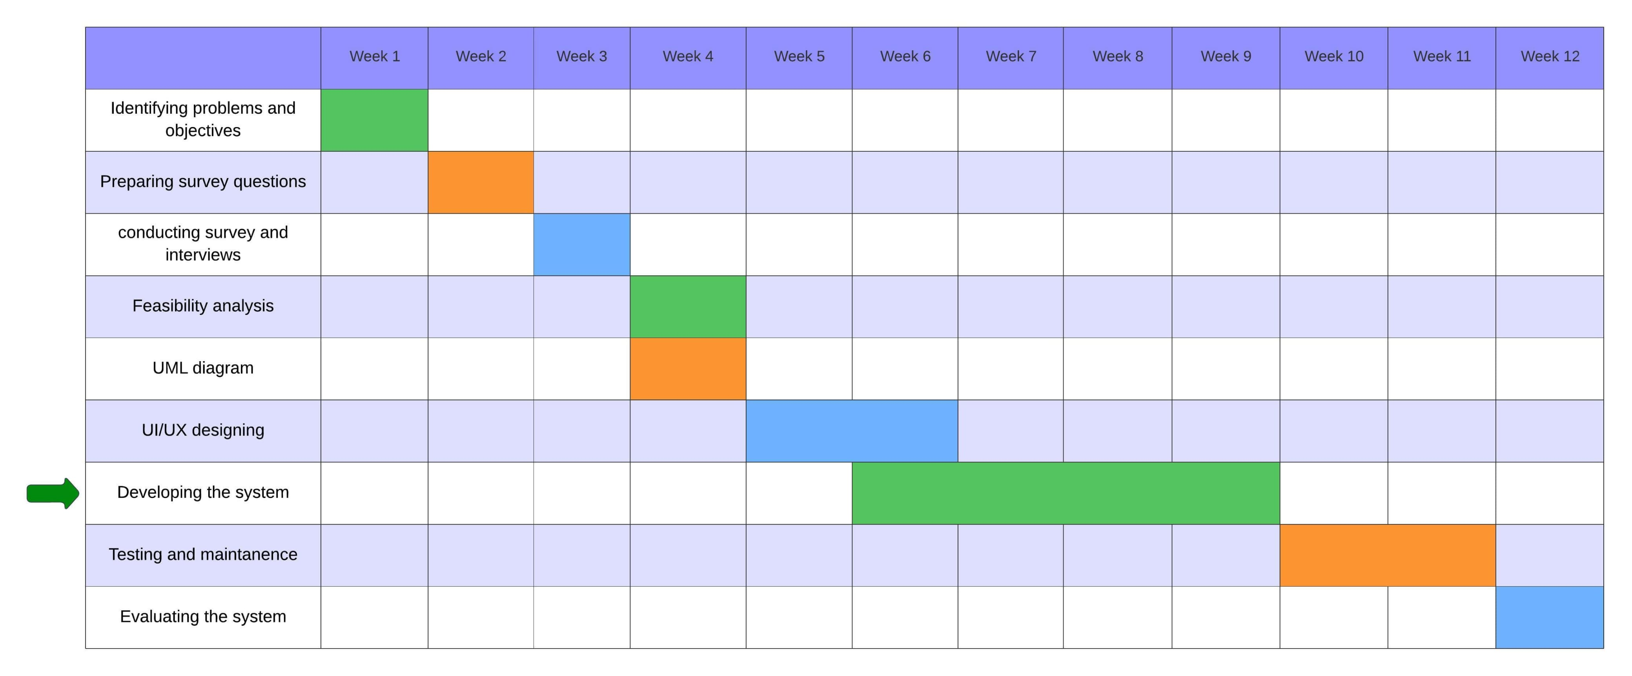
Timeline

Slide 15









Tools & Techniques
Front-End Development:
Back-End Development:

Slide 16
Team Collaboration
Members
Md Mehedi Hasan | Full Stack Developer
Mushfiqur Rahman Pulok | Front-End Developer & System Analyst
Abdullah Al Hill Baki | Documentation
Mehedi Hasan Pranto | Quality Assurance
Mahmuda Adeeba Tul Husna | System Analyst
Tools: Used GitHub for code collaboration and task management.

Slide 17


Slide 18


